Slide 1
SPRING VALLEY VILLAGE POLICE DEPARTMENT
MONTHLY NEWSLETTER:
FEBRUARY 2024
1025 CAMPBELL ROAD
HOUSTON, TX 77055
PHONE: 713-465-8323
COMMUNITY MATTERS.
WE ARE A TEAM.

Slide 2
INTRODUCTION
Hilshire Village Residents,
We hope the new year has gotten off to a good start for everyone. IRS scams usually increase with the beginning of tax season. We want to remind everyone to remain vigilant against IRS phishing attempts. Beware of anyone claiming to be with the IRS who contacts you by phone or email. Real IRS agents will initiate contact through regular mail or in-person. They will not threaten to revoke licenses or have people arrested.
Never provide your personal information, Social Security number, bank account information, or credit card numbers to anyone who calls and ask for it unless you are certain of who you are dealing with. Remember that the IRS does not accept payment made via gift cards. Below are a few more things to keep in mind while you go about your day to day activities. As always we are available whenever you have concerns.
KEEP IN MIND:
Be sure to lock all doors and windows in your home, when you are not on the premises.
Lock your vehicle when it is unoccupied.
Be cautious while in and around our school zones
Sincerely,
Chief M. Schulze
COMMUNITY MATTERS.
WE ARE A TEAM.
1025 CAMPBELL ROAD, HOUSTON, TX 77055
PHONE: 713-465-8323 / EMAIL: DISPATCH@SPRINGVALLEYTX.COM

Slide 3
FEBRUARY 2024
DATE | DAY | SPECIAL DAYS FOR THIS MONTH
02-14-2024 | WEDNESDAY | VALENTINE’S DAY
02-19-2024 | MONDAY | PRESIDENT’S DAY
COMMUNITY MATTERS.
WE ARE A TEAM.
1025 CAMPBELL ROAD, HOUSTON, TX 77055 / PHONE: 713-465-8323 / EMAIL: DISPATCH@SPRINGVALLEYTX.COM

Slide 4
PPublic Service Announcement (PSA) From Our Officers:
Spring Valley Village PD offers a House Watch Program for residents while away on vacation or holidays. Either call Dispatch or email the form found in this newsletter and on the Police Department website.
Lt. C. Menchaca
Please pay attention to school buses loading and unloading children during the morning and afternoon. When the school bus is stopped and the red lights are flashing, motorists must stop. Also pay attention to school zones and crosswalks. Let’s all do our part for the safety of our children.
Officer N. Hale
When you call in an emergency be sure to stay on the line, and be as calm as possible. Answer all questions. Give the dispatcher your address or describe your location, giving landmarks when possible.
TCS D. Gonzalez
COMMUNITY MATTERS.
WE ARE A TEAM.
1025 CAMPBELL ROAD, HOUSTON, TX 77055 / PHONE: 713-465-8323 / EMAIL: DISPATCH@SPRINGVALLEYTX.COM

Slide 5
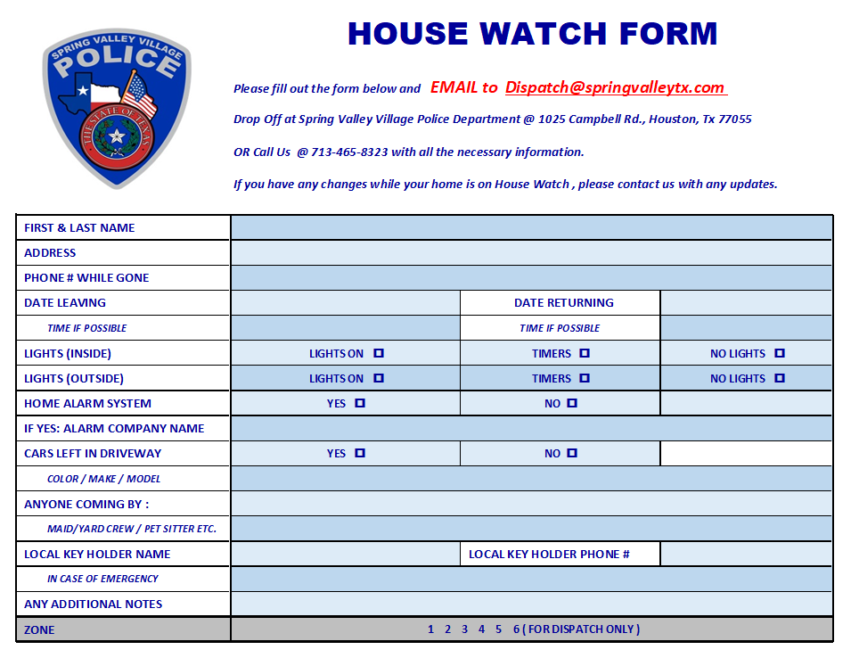
TIPS TO PREP BEFORE LEAVING
Close windows, blinds, curtains, shutters, lock all doors and garage.
Set timers on interior lights. This goes a long way in deterring burglars, who often look for crimes of opportunity.
Set your thermostat accordingly, for unnecessary energy cost, but can also help avoid unforeseen problems with you HVAC equipment.
Take out the trash.
Run garbage disposal until clear.
Secure all valuables.
Lock all vehicles that are at home.
Turn on home security system.
Arrange for pets left at home.

Slide 6
IDENTITY THEFT
What are the 3 types of identity theft?
Financial Identity Theft
Medical Identity Theft
Online Identity Theft
Identity theft, also known as identity fraud, is a crime in which an imposter obtains key pieces of personally identifiable information (PII), such as Social Security or driver's license numbers, to impersonate someone else.
COMMUNITY MATTERS.
WE ARE A TEAM.
1025 CAMPBELL ROAD, HOUSTON, TX 77055
PHONE: 713-465-8323 / EMAIL: DISPATCH@SPRINGVALLEYTX.COM

Slide 7
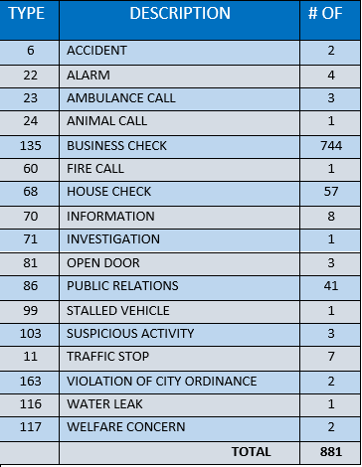
SPRING VALLEY POLICE DEPARTMENT
HILSHIRE VILLAGE
CALLS BY TYPE: 01/01/2024 THRU 01/31/2024
COMMUNITY MATTERS.
WE ARE A TEAM.
1025 CAMPBELL ROAD, HOUSTON, TX 77055
PHONE: 713-465-8323 / EMAIL: DISPATCH@SPRINGVALLEYTX.COM

Slide 8
IMPORTANT NUMBERS AT A GLANCE
EMERGENCY |  | NON - EMERGENCY
911 - FOR ALL EMERGENCY |  | 713-465-8323
988 – NATIONAL SUICIDE & MENTAL HEALTH
SPRING VALLEY VILLAGE |  | VILLAGE FIRE DEPARTMENT
SPRING VALLEY - CITY HALL | 713-465-8308 | VILLAGE FIRE DEPARTMENT |  | 713-465-2323
SPRING VALLEY - PD | 713-465-8323 | VFD - NON-EMERGENCY |  | 713-468-7941
SPRING VALLEY - PD FAX | 713-465-3135
SPRING VALLEY - COURT | 713-465-0333
HILSHIRE VILLAGE
HILSHIRE VILLAGE – CITY HALL | 713-973-1779
COMMUNITY MATTERS.
WE ARE A TEAM.
1025 CAMPBELL ROAD, HOUSTON, TX 77055 / PHONE: 713-465-8323 / EMAIL: DISPATCH@SPRINGVALLEYTX.COM

